Slide 1
Advanced materials processing with intelligent systems
Light materials interaction
Sergey Shevchik & Patrik Hoffmann
References:
https://micro.magnet.fsu.edu/primer/virtual/virtual.html

Slide 2
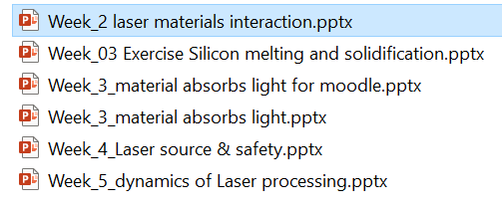
Content

Slide 3
Content
Light meets materials
  Reflection
  Absorption
  Transmission
  Scattering

Slide 4
Light meets material
Light meets materials
  Reflexion
  Absorption
  Transmission
  Scattering

Slide 5
Fresnel Equations
Light intensity (Power) coefficients:
In case of normal incidence:
Do not forget to use complex refractive index, if absorption is present!
, etc.
normal incidence
general case

Slide 6
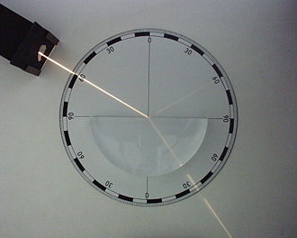
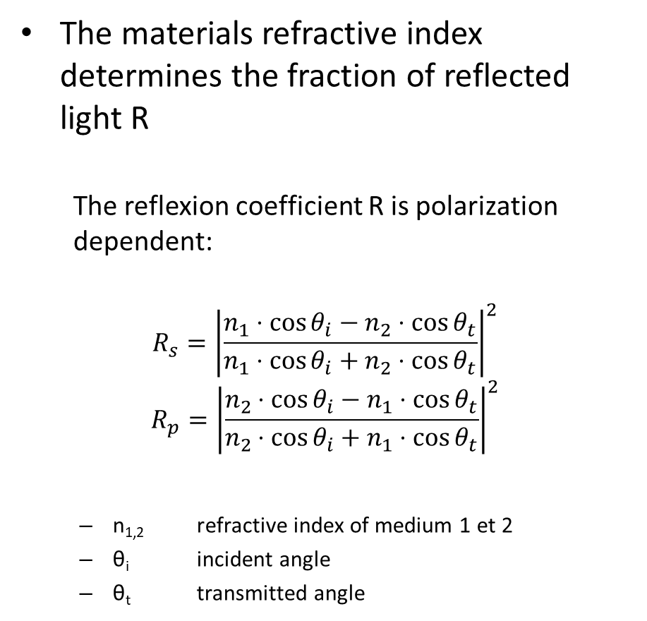




Fresnel coefficients
The materials refractive index determines the fraction of reflected light R
  The reflexion coefficient R is polarization dependent:
$$R_{s}={\left|\frac{n_{1}⋅\cos{θ_{i}}−n_{2}⋅\cos{θ_{t}}}{n_{1}⋅\cos{θ_{i}}+n_{2}⋅\cos{θ_{t}}}\right|}^{2}$$
$$R_{p}={\left|\frac{n_{2}⋅\cos{θ_{i}}−n_{1}⋅\cos{θ_{t}}}{n_{2}⋅\cos{θ_{i}}+n_{1}⋅\cos{θ_{t}}}\right|}^{2}$$
  n_{1,2} refractive index of medium 1 et 2
  θ_{i} incident angle
  θ_{t} transmitted angle
Can the reflected light intensity be calculated?
$$θ_{i}$$
$$n_{1}$$
$$n_{2}$$
$$θ_{t}$$

Slide 7
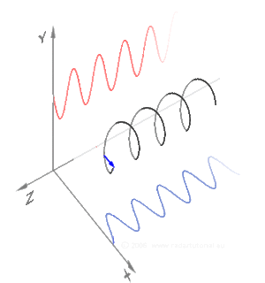
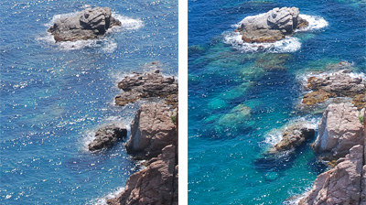
Polarisation
What is polarization?
For linearly polarized light:
  s – polarisation Ʇ (senkrecht; german for perpendicular)
    Electric field vector perpendicular to light propagation plane
  p - polarisation II (parallel)
    Electric field vector lies in the light propagation plane
  polarization filters are often used in photographie

Slide 8
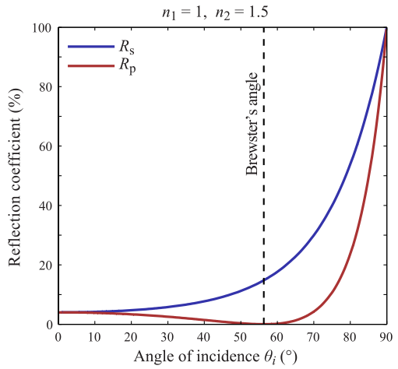
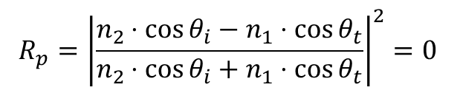

Angle de Brewster
$$R_{p}={\left|\frac{n_{2}⋅\cos{θ_{i}}−n_{1}⋅\cos{θ_{t}}}{n_{2}⋅\cos{θ_{i}}+n_{1}⋅\cos{θ_{t}}}\right|}^{2}=0$$
with Snell-Descartes law
$$θ_{B}=\arctan\left(\frac{n_{2}}{n_{1}}\right)$$

Slide 9
Reflection
Excited dipoles cannot reemit light in the direction parallel to the dipole vector ⇒ no reflected light if,
Brewster Angle

Slide 10
Reflection
machining under Brewster angle
(increase absorption for metals)

Slide 11
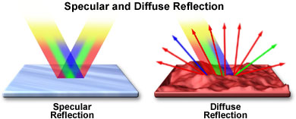
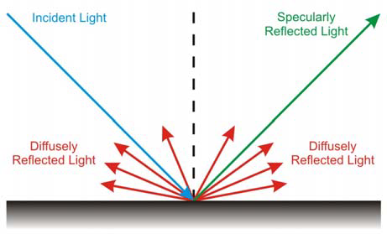
Diffuse reflectance
https://micro.magnet.fsu.edu/primer/java/reflection/specular/index.html

Slide 12
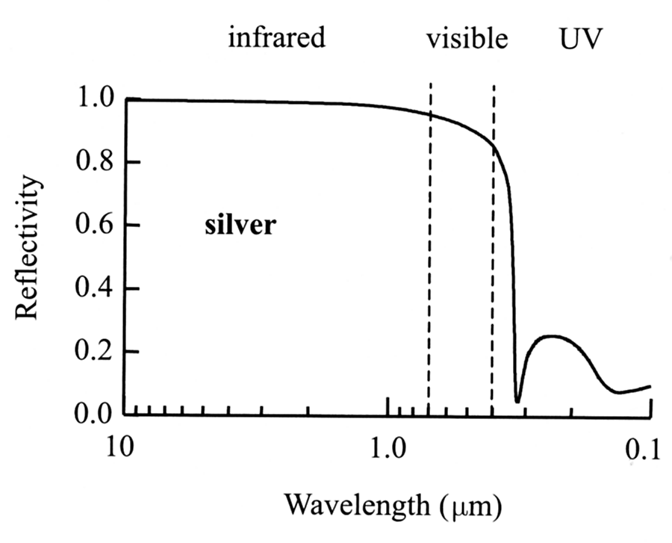
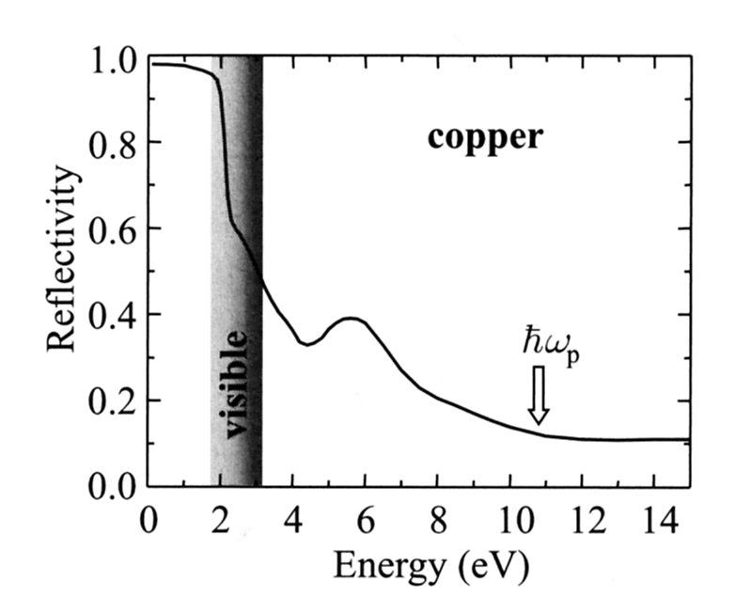
Optical properties of Metals
Metals are shiny and typically not transparent
What would be the best laser for metal processing?

Slide 13
Electrons in Metal
in metal electrons are not bounded ⇒ free-electron plasma
acceleration
damping
E-field driving force
“spring” (returning force) term is not present
dielectric constant for free-electron plasma (in first approximation for metals):
plasma frequency

Slide 14
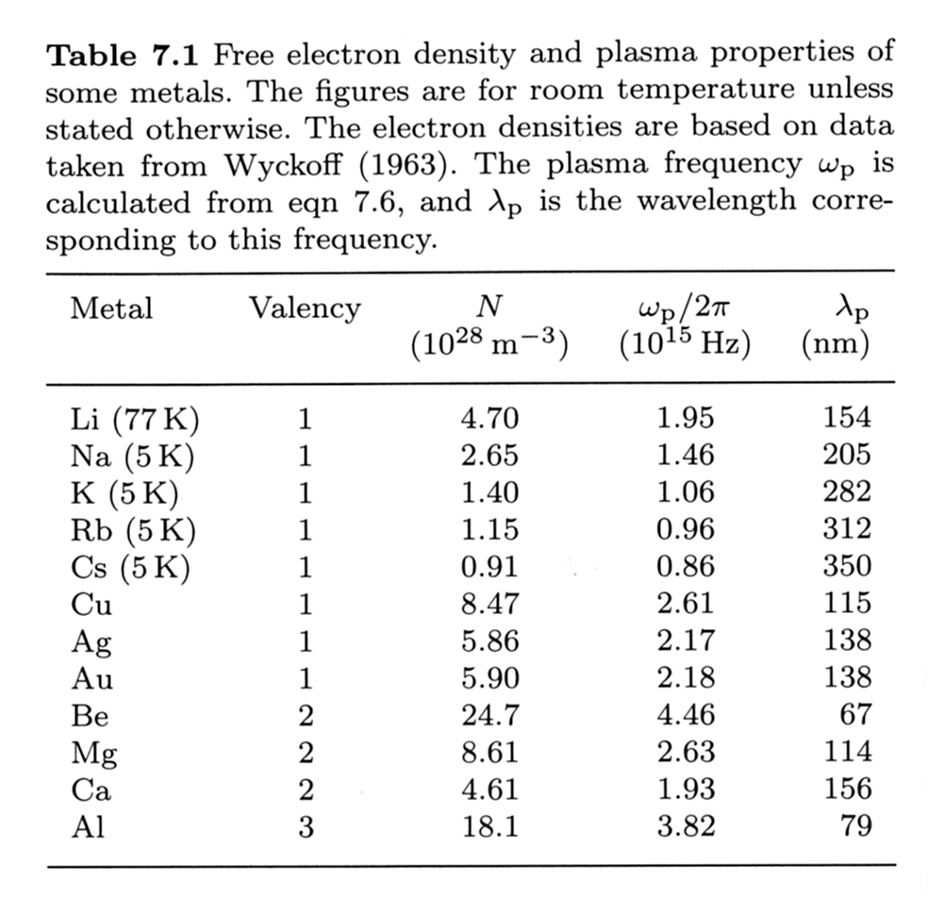
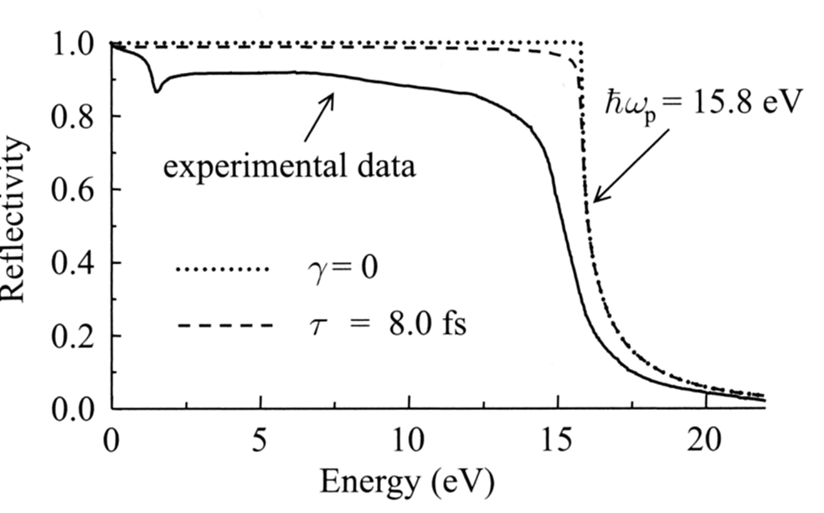
Theoretical Plasma Frequencies
reflectivity of free-electron gas and
real metal (Al)

Slide 15
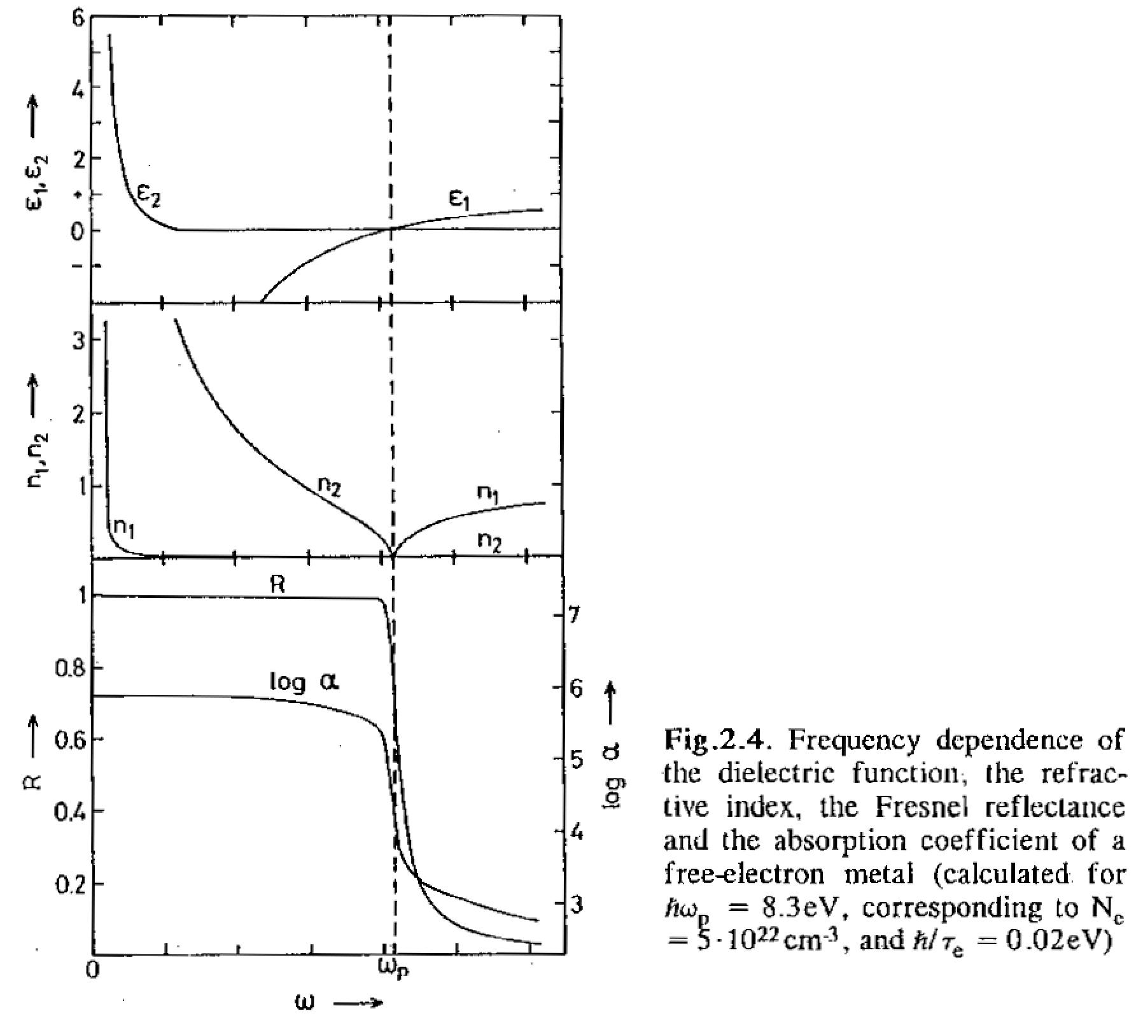
Frequency Dependence
Frequency dependence of dielectric function, refractive index, Reflectance and absorption coefficient for free-electron plasma (metal)
(for ħω_{p}=8.3 eV, N_{e}=5x10²² cm⁻³, ħ/τ=0.02 eV)
Notes:
plasma frequency of Au and Cu are in the visible range

Slide 16
Dielectric Constant and Conductivity
conductivity and plasma frequency of a metal are directly linked
(link between optical and electrical properties)

Slide 17
Reflection of Al, Ag & Au
Notes:
Reflection coeffician can not be in [µm]!!!!!!!!!!!

Slide 18
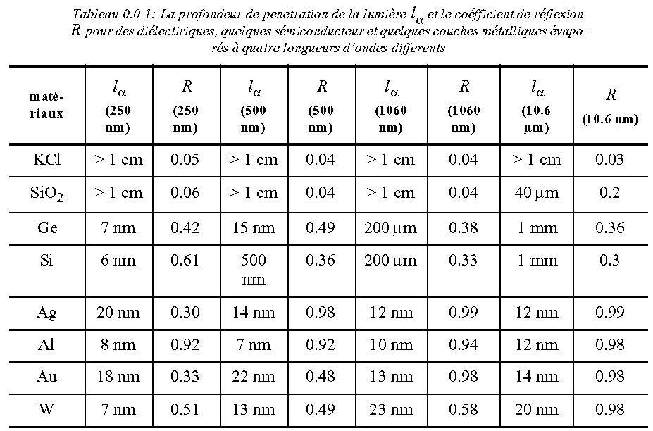
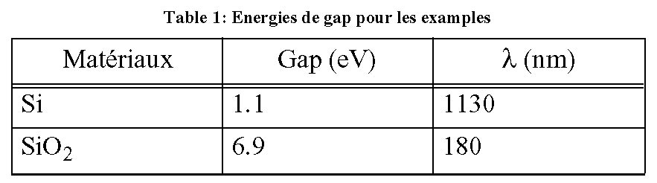
Reflection coefficients and penetration depth for some Materials
for metals for frequencies between:
1/τ_{e} < ω < ω_{p} (optical, vis.)
Notes:
mark the rows (materials), (diaelectric, good/bad metels, …)
optical , thermal penetratin depthe
AgCl – fibers for CO2 laser

Slide 19
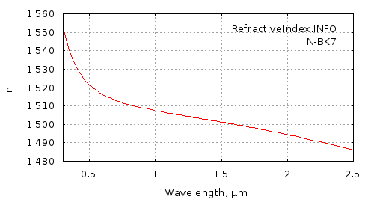

dependances
Index of refraction is wavelength dependent
Reflection depends on polarisation
589 nm sodium Na line
  n_{1,2} indice de réfraction des milieux 1 et 2

Slide 20
Light meets material
Light meets materials
  Reflexion
  Absorption
  Transmission
  Scattering

Slide 21
Light absorption
Light that is absorbed makes a photon disappear !
  Where is the energy going?
Light that is deviated only, does not loose energy!
  Reflection
  Transmission
  Scattering

Slide 22
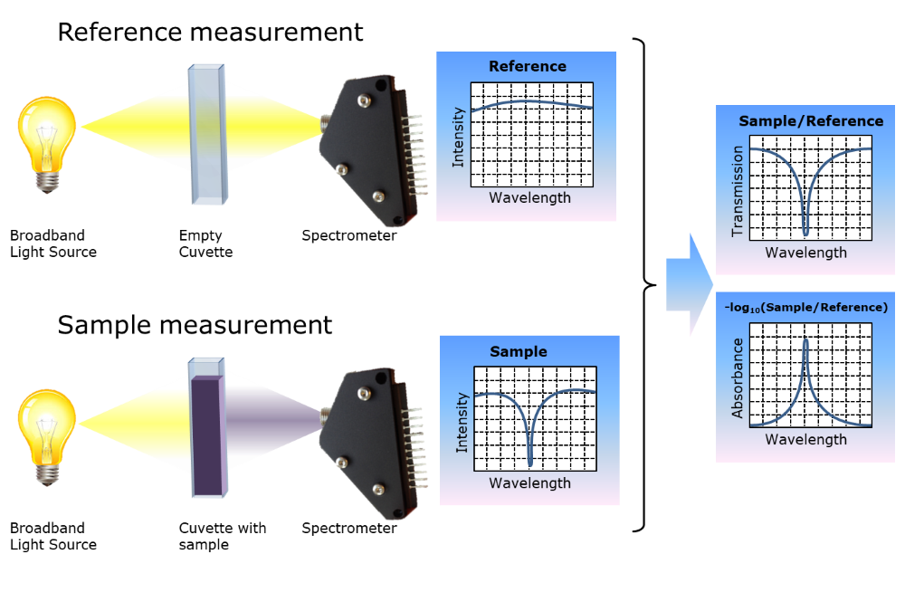
Absorption
Light meets materials
  Absorption

Slide 23
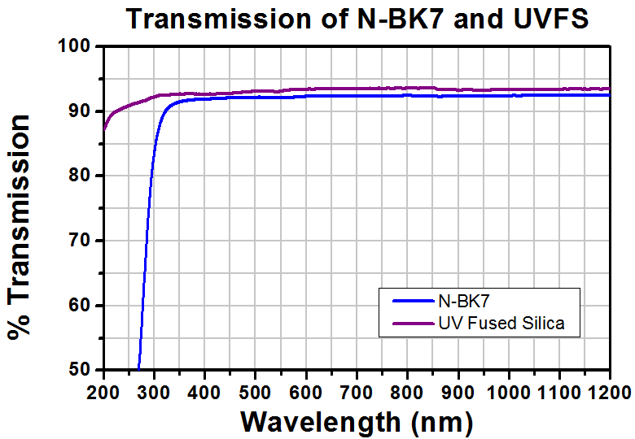
Absorption – Transmission index of refraction

Slide 24
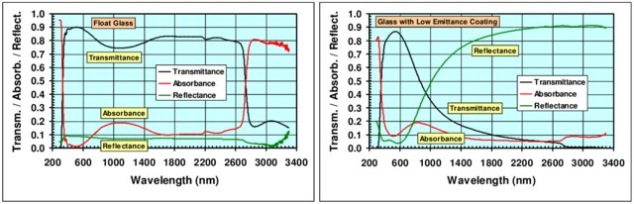
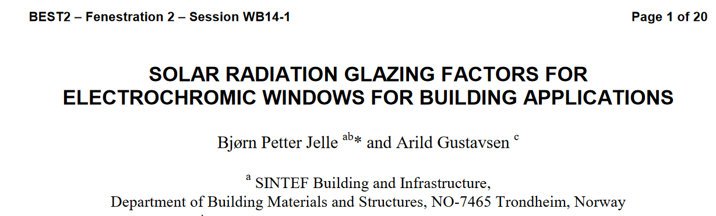
Absorption – Transmission index of refraction

Slide 25
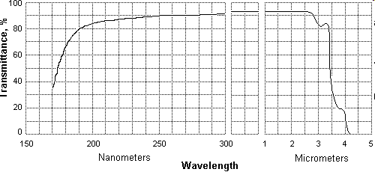
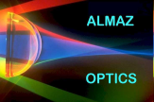
Transmission Spectra (Fused Silica)
Synthetic Grade Fused Silica (SiO2, 10 mm)
Absorption due to electronic band to band transitions (band gap)
Absorption due to excitation of lattice vibrations (phonons)
Almaz Optics Inc.
http://www.almazoptics.com

Slide 26
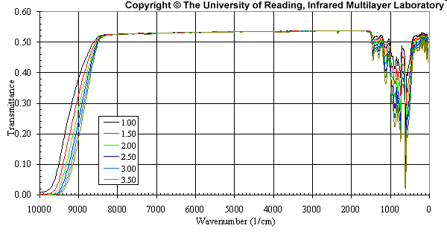

Transmission Spectra (Silicon)
Calculated transmission profiles of hyperpure Fz Silicon (Si) at 293K for substrate thicknesses between 1.0 and 3.5mm
Silicon (5 mm) transmission.
(pure and oxygen contaminated)
Arrows point to the oxygen absorption peaks.
Absorption due to electronic band to band transitions (band gap)
Absorption due to excitation of lattice vibrations (phonons)
Tydex J.S.Co
http://www.tydex.ru
Notes:
hide explanations to let students interpret the spectra

Slide 27
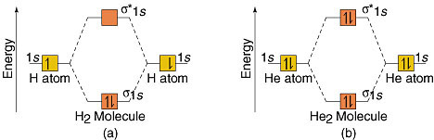
Electronic absorption: Energy Levels

Slide 28
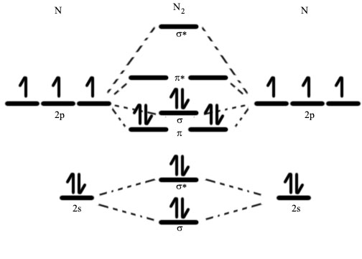
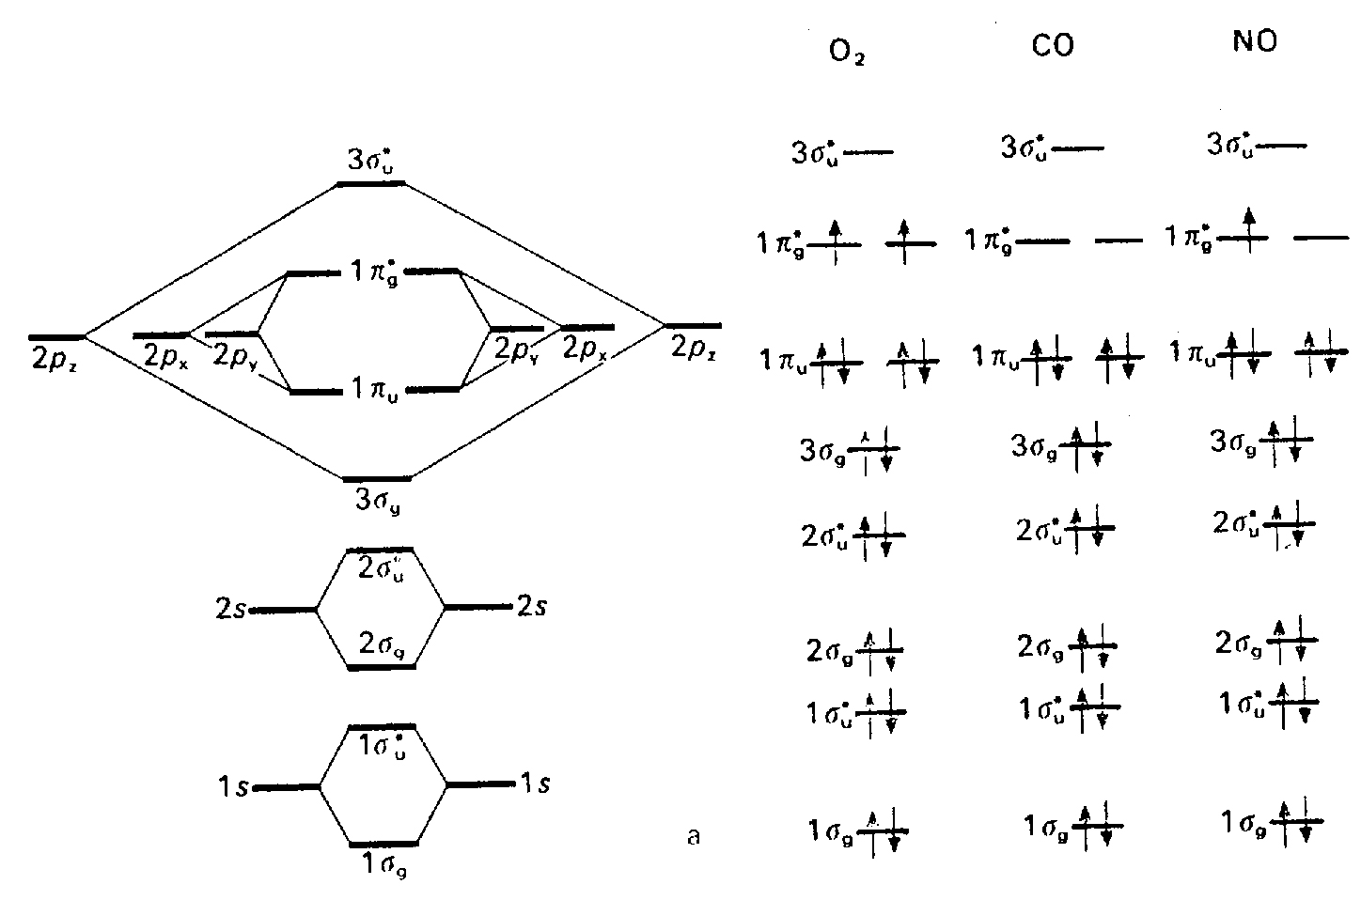
Light absorption in a Gaseous Molecule
By TCReuter - Own work, CC BY-SA 4.0, https://commons.wikimedia.org/w/index.php?curid=49416990

Slide 29
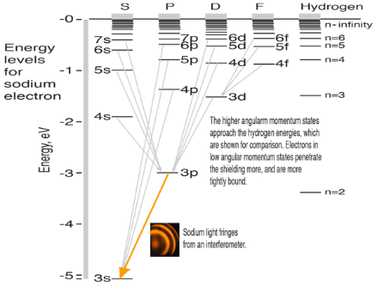
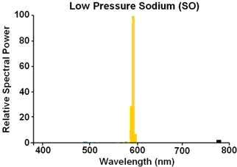
Sodium D-line
Cold sodium vapor (300°C) emits only light at 589,00nm and 589,59nm this sodium - D-line for doublet is almost monochromatic

Slide 30
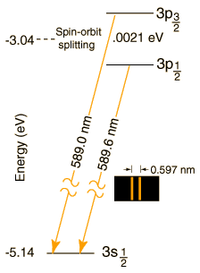
Sodium D-line – why is it a doublet ?
What happens if you put the Na vapor in a magnetic field ?
Could not have asked Pieter Zeeman when he discovered the effect in 1896 !

Slide 31
Absorption
macroscopic (“black box”) description of absorption
Types of Absorption /Excitation
Absorption | Wavelength (nm)
electronic molecular(σ, π) | 10-150 – 1000-2000
electronic interband | 150 – 1000-2000
vibrational | 900 – 10’000
rotational | > 10’000

Slide 32
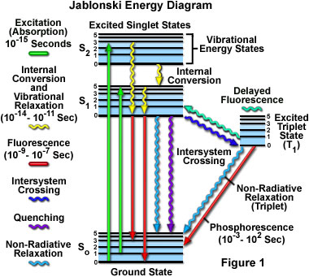
Absorption & Fluorescence
Absorption & fluorescence in a single molecule, ion, atom
!
non-radiative transition → transformation into heat
http://micro.magnet.fsu.edu/primer/techniques/fluorescence/fluorescenceintro.html

Slide 33
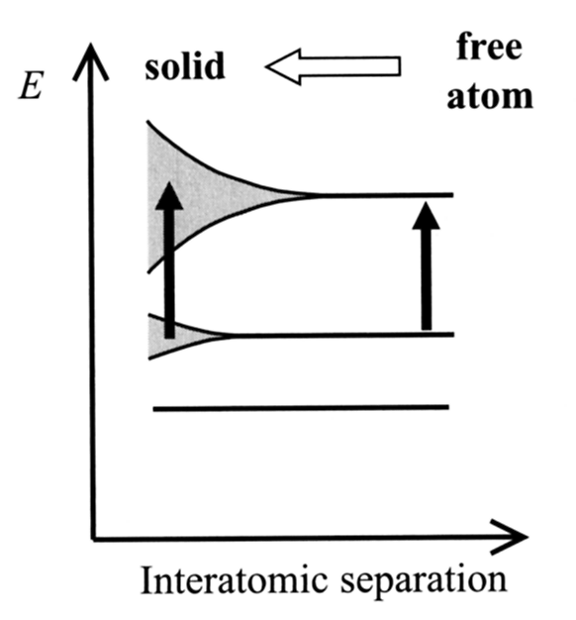
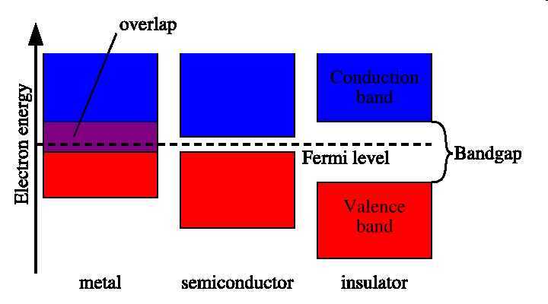
Band Structure of Solids
http://en.wikipedia.org/wiki/Band_structure
Notes:
electrons not a gas but occupy certain quantum states – which overlap into a band
electron are fermions

Slide 34
Band Gap Absorption
hν
+
=
Only photons with energy larger than the band gap of material are absorbed
Inter band absorption grates free charge carriers – new centers of absorption

Slide 35
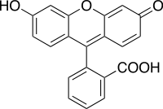
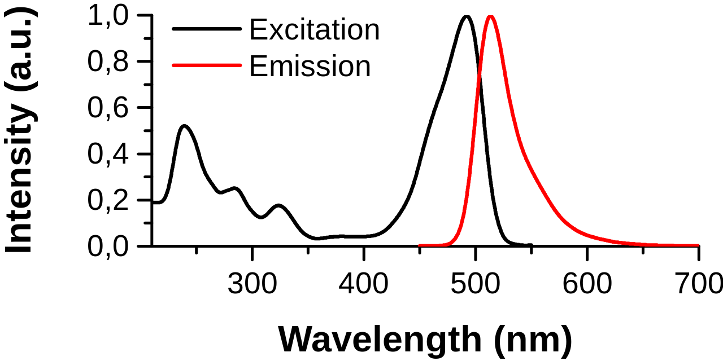
Fluorescein
Formula of Fluorescein

Slide 36
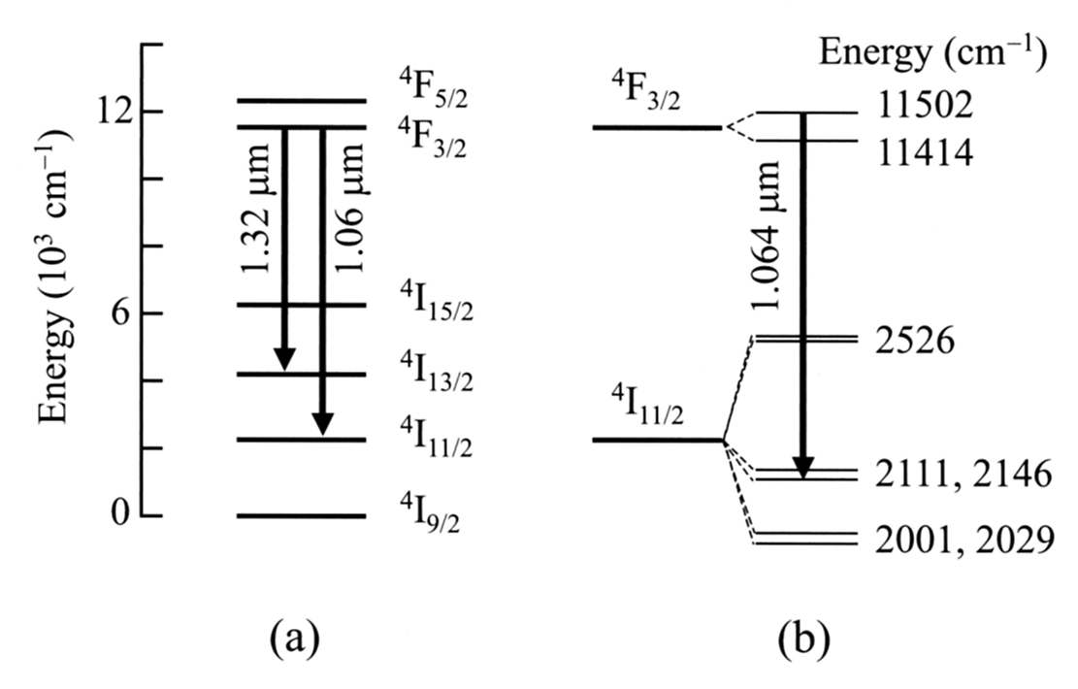
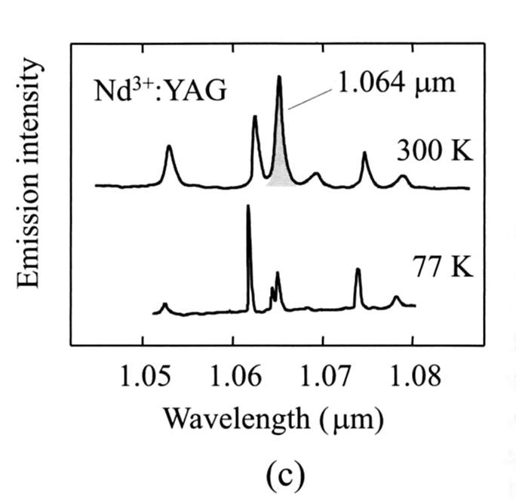
Absorption/Luminescence Centers in Solids
Emission spectrum of
Nd³⁺-ion in YAG crystal
Energy Level Diagram of Nd³⁺-ion in YAG crystal

Slide 37
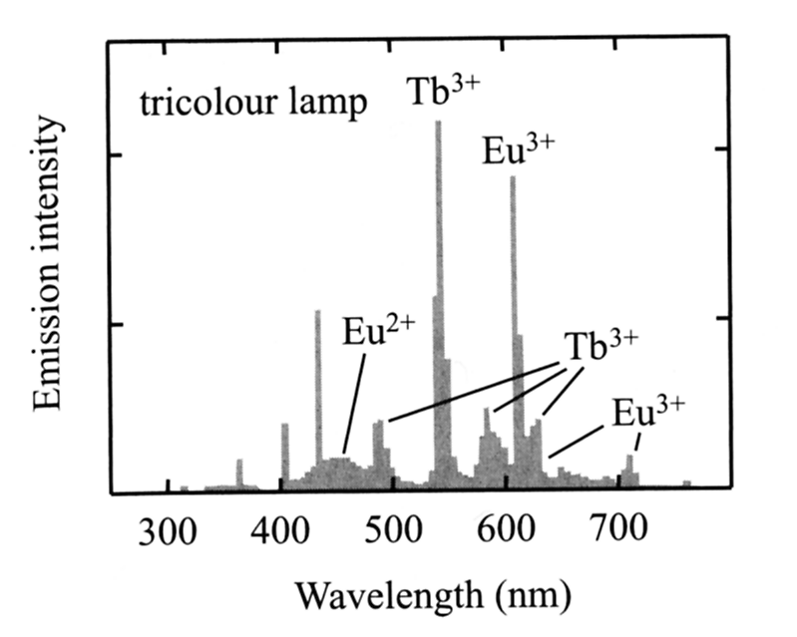
Emission of Luminescent Lamp
emission of luminescent lamp is composed of narrow line emission of a mixture of phosphors

Slide 38
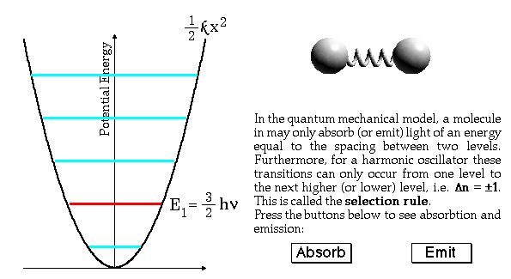
Vibronic Transitions and Infrared Spectroscopy
Vibration of a di-atomic molecule
quantized harmonic oscillator
Selection rules for oscillation to be visible in IR spectroscopy: the dipole moment of a molecule have to change when undergoing the transition
quantized unharmonic oscillator
Notes:
PERKIN_ELMER spectroscopy tutorial

Slide 39
Infrared Spectroscopy

Slide 40
Schematic of Infrared Spectroscopy
En pivotant le réseau (en anglais grating, prisme réflectif), la longueur d’onde arrivant sur l’échantillon est scannée.
L’absorption dans l’échantillon varie avec la longueur d’onde.
On obtient sur le détecteur un spectre IR.
Aujourd’hui on utilise la transformée de Fourier dans les machines, pour augmenter la vitesse et la precision.

Slide 41
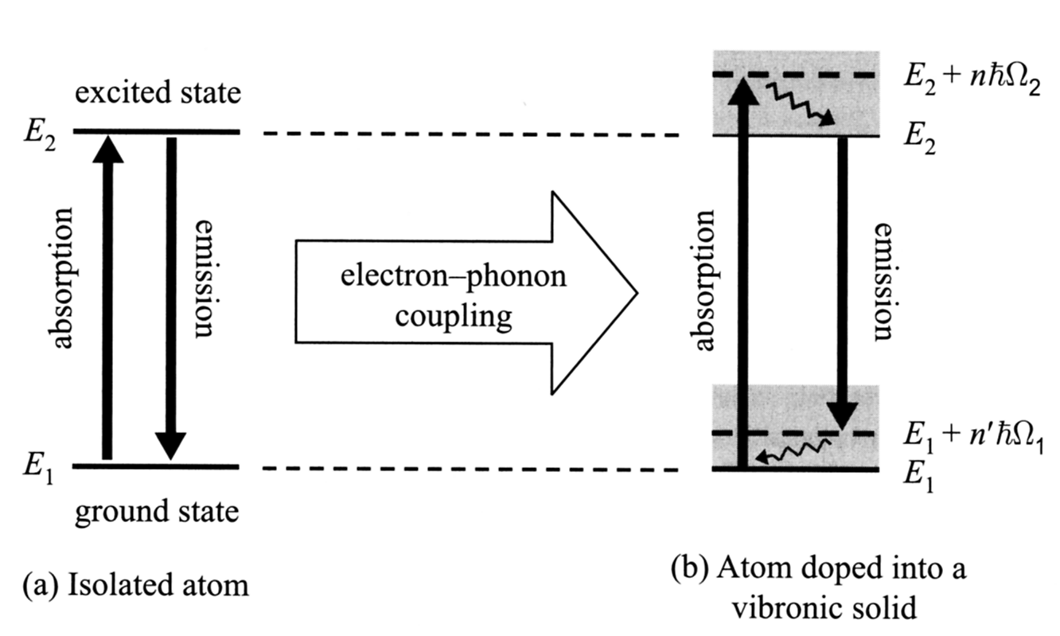
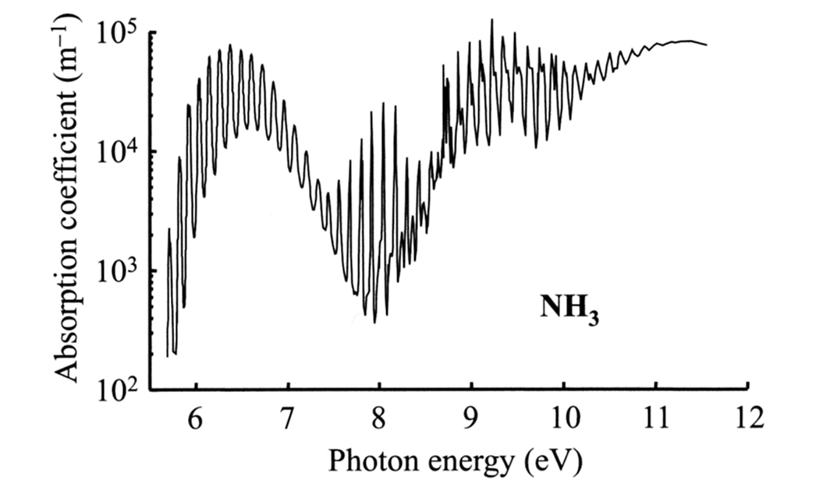
Electronic and Vibronic Trasitions
electronic and vibronic transition often interact – broadening of the transitions (emission / absorption peaks)

Slide 42
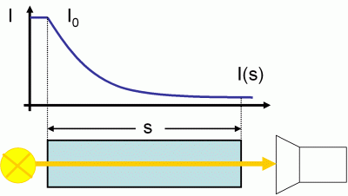
Absorption
for linear absorption lost intensity in a thin layer is proportional to incident intensity
which results in a Beer-Lambert law
α - absorption coefficient
l_{α}=1/α - penetration depth (characteristic absorption length)

Slide 43
Measures of Absorption
absorption coefficient and extinction coefficient
optical density – a logarithmic unit:
complex refractive index and complex dielectric constant:

Slide 44
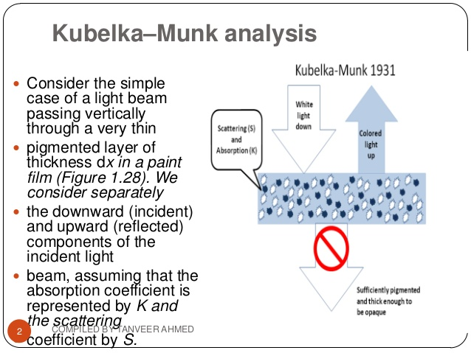
Partially transparent scattering media

Slide 45
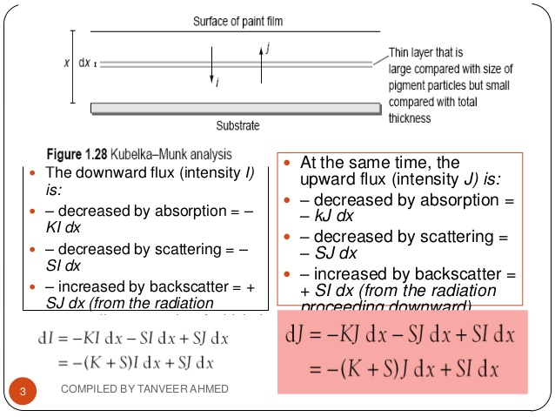
Kubelka - Munk

Slide 46
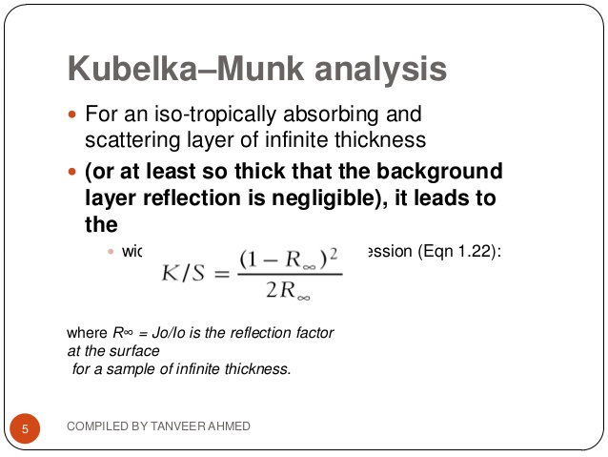
Kubelka - Munk

Slide 47
Scattering
λ~d ⇒ Mie Scattering
λ>>d ⇒ Rayleigh Scattering
Notes:
demostration: laser sapphire and aluminium ceramics

Slide 48
Effective Medium Approximation
ε₁ - inclusion dielectric constant
ε₀ - matrix medium dielectric constant
ε_{eff} – effective dielectric constant
η₁ – volume fraction of inclusions
Maxwell-Garnett Equation
formula valid only for low concentraitions η₁ and small difference between ε₁ and ε₀

